Slide 1

Exploratory Data Analysis
Week3 – Investment Analysis in the Cab Industry
20-Dec-2023

Slide 2
Agenda
Executive Summary
Problem Statement
Approach
EDA
EDA Summary
Recommendations

Slide 3
Executive Summary
XYZ is a private equity firm in US. Due to remarkable growth in the Cab Industry in last few years and multiple key players in the market, it is planning for an investment in Cab industry.
Objective : To identify the best investment option in the U.S. cab industry for XYZ Company.
Method: Comprehensive analysis of provided datasets using exploratory data analysis(EDA).
Key Finding: Substantial differences in average fare and travel distance between Pink and Yellow Cab companies.

Slide 4
Problem Statement
XYZ Company is considering an investment in the U.S. cab industry.
Need to determine the most promising investment target based on market and operational data analysis.

Slide 5
Approach
Collected and analyzed data from three CSV file: Cab_data, City, and Customer_ID.
Conducted EDA to uncover patterns, trends, and insights.
Used Python with libraries like pandas for data manipulation and seaborn for visualization.

Slide 6
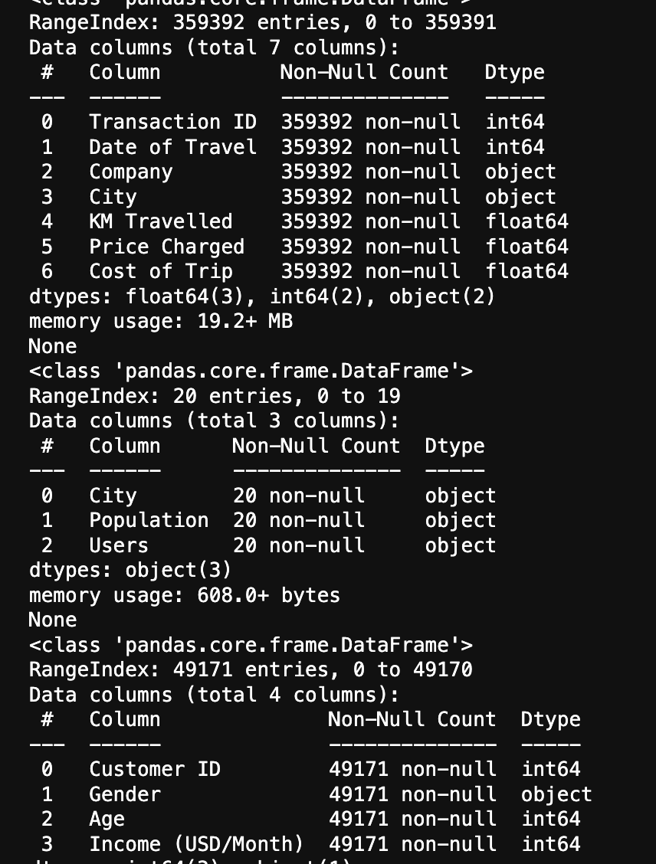
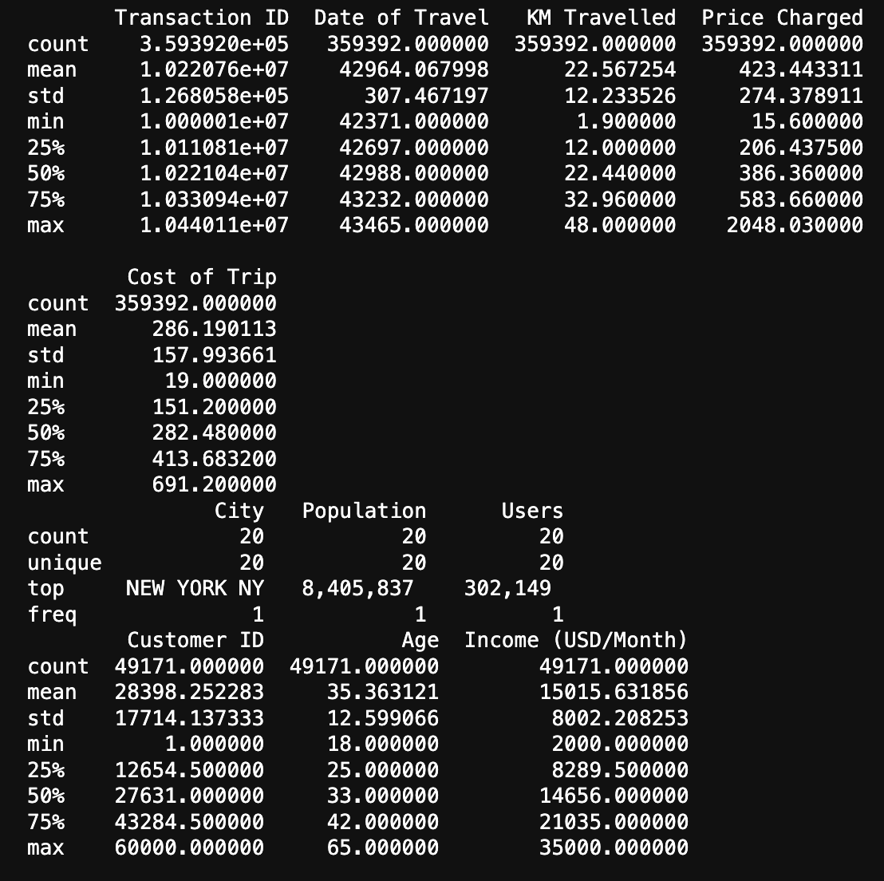
EDA
Investigated basic dataset statistics to understand the scale and operations of the cab companies.
Found no missing values; datasets are clean and well-structured for analysis.
Analyzed customer demographics to assess market segmentation potential.

Slide 7
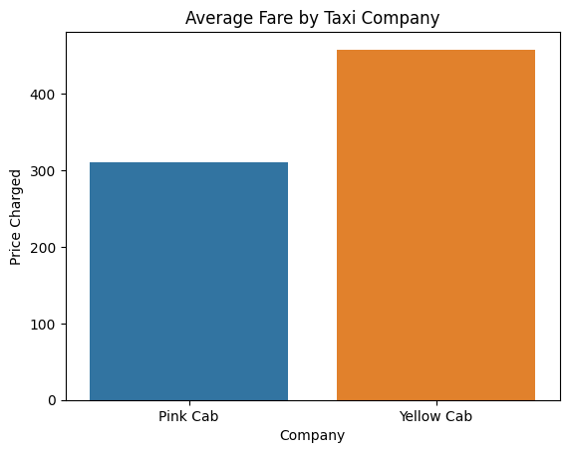
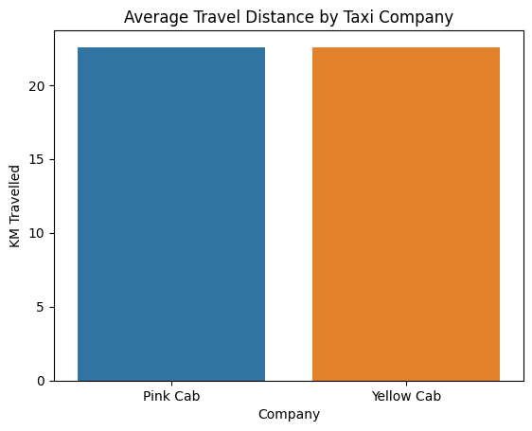
EDA Summary
Visual data analysis shows Yellow Cab has a higher averaged fare and longer travel distance than Pink Cab.
Statistical summaries indicate significant transaction volume and consistent customer usage.

Slide 8
Recommendations
Based on initial findings, Yellow Cab may offer a more lucrative investment opportunity due to higher fares and longer average distances traveled.
Suggest further analysis on profitability and customer satisfaction for a comprehensive understanding.

Slide 9
Conclusion
Data-driven insights are vital for making informed investment decisions in the competitive cab industry.
XYZ Company should consider both quantitative data and qualitative factors for their investment strategy.

Slide 10
Thank You

